Slide 1
Mario game rules

Slide 2
Watch the video here
https://www.youtube.com/watch?v=rLl9XBg7wSs&ab_channel=Pii89

Slide 3
Other rules
MUSHROOM: make bigger
If I hit with Mario = I disappear.
FLOWER: give fire
If I hit with Mario = I disappear.
STAR: give invulnerable
If I hit with Mario = I disappear.
CHECKPOINT:
If I hit with Mario = i change color to blue.
CAMERA:
Camera always follow Mario
ENEMY
If Mario hit me on the top = I will die.
If Mario hit me but Mario has the STAR = I will die.

Slide 4
MARIO rules
If I hit the star, I become invincible for XXX seconds
If I hit the mushroom,
I become XXX scale
If I hit an enemy:
If I am big, I become small
If I am small:
minus 1 life.
If I have 0 life, I die
If I am invincible, enemy die
If I hit green mushroom, I get 1 life
If I hit checkpoint, save the location of the checkpoint
If I die, move me to the last saved checkpoint
on start of game:
Give mario 2 life
Save start as checkpoint
Collect coins:
Add score (ui),
Sound / animation / …
Coin will disappear when hit mario.

Slide 5
COINS
LIVES
Moving Platform

Slide 6
Until 10:30 everybody work
10:30 we all come back to the main room.
Every mini team shows his result.

Slide 7
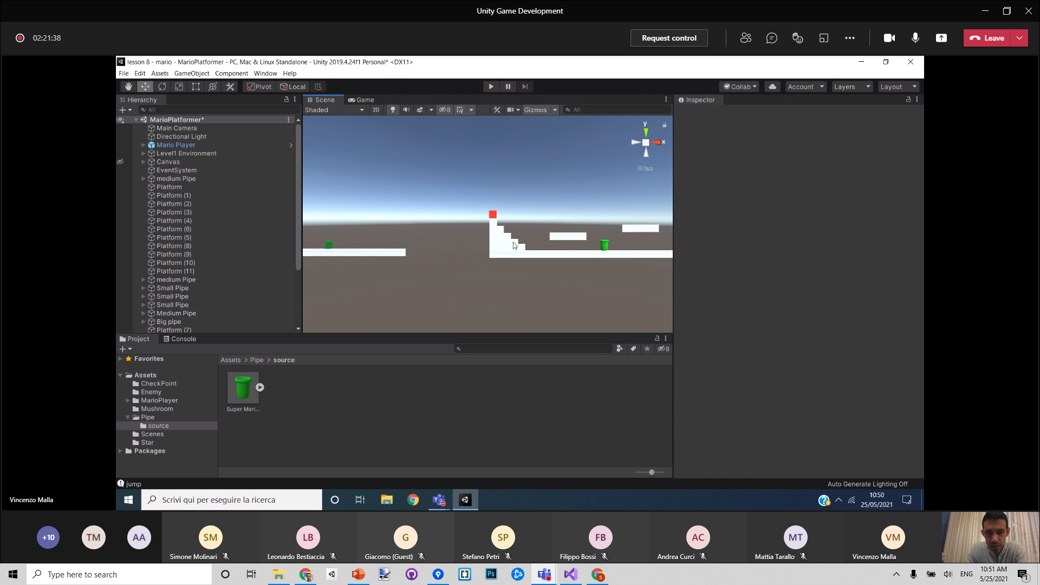

Slide 8
mario
star
enemy
Mario
star
star
enemy
Mario star
enemy

Slide 9
coin
box
mario
coin

Slide 10
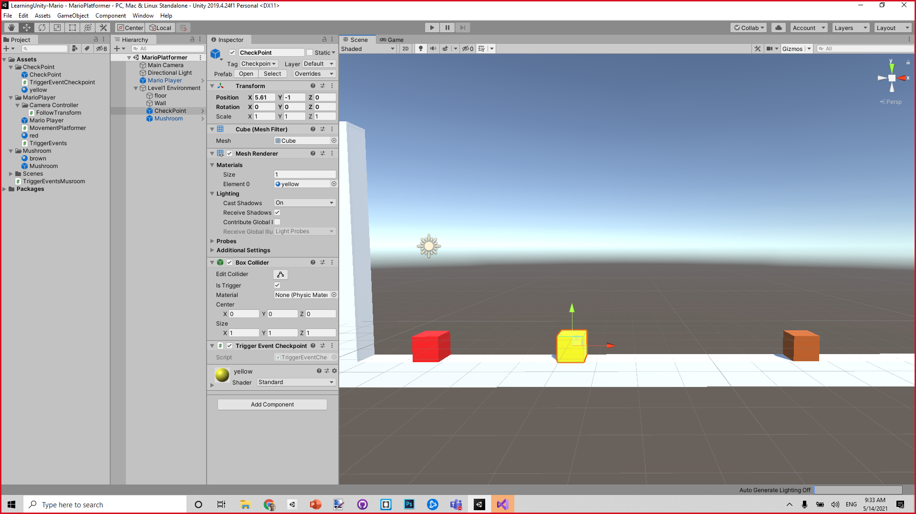
checkpoint
mushroom

Slide 11
How to start developing the game
Make the avatar move
OnKey RIGHT , go right
OnKey LEFT, …
OnKeyDown Press UP, jump (physics or animation...).

Slide 12
Plan
Insert 3d model inside the cube (Filippo)
All the big features:
Mushroom, star, enemy
Complete game cycle
Menu system
Level design (make it fun).
From Starting point to finish point
Change rules:
Health, damage,
Fire
Killing stuff
Animations
Sound effects
Visual effects

Slide 13
Menu system
Welcome to MARIO 2021
If click START GAME button:
Close start screen
START GAME

Slide 14
The actual game……

Slide 15
Ohhhhh, too bad…
game over
If click RESTART button
Remove restart screen
Restart level()
RETRY

Slide 16
Invisible colliders to activate

Slide 17
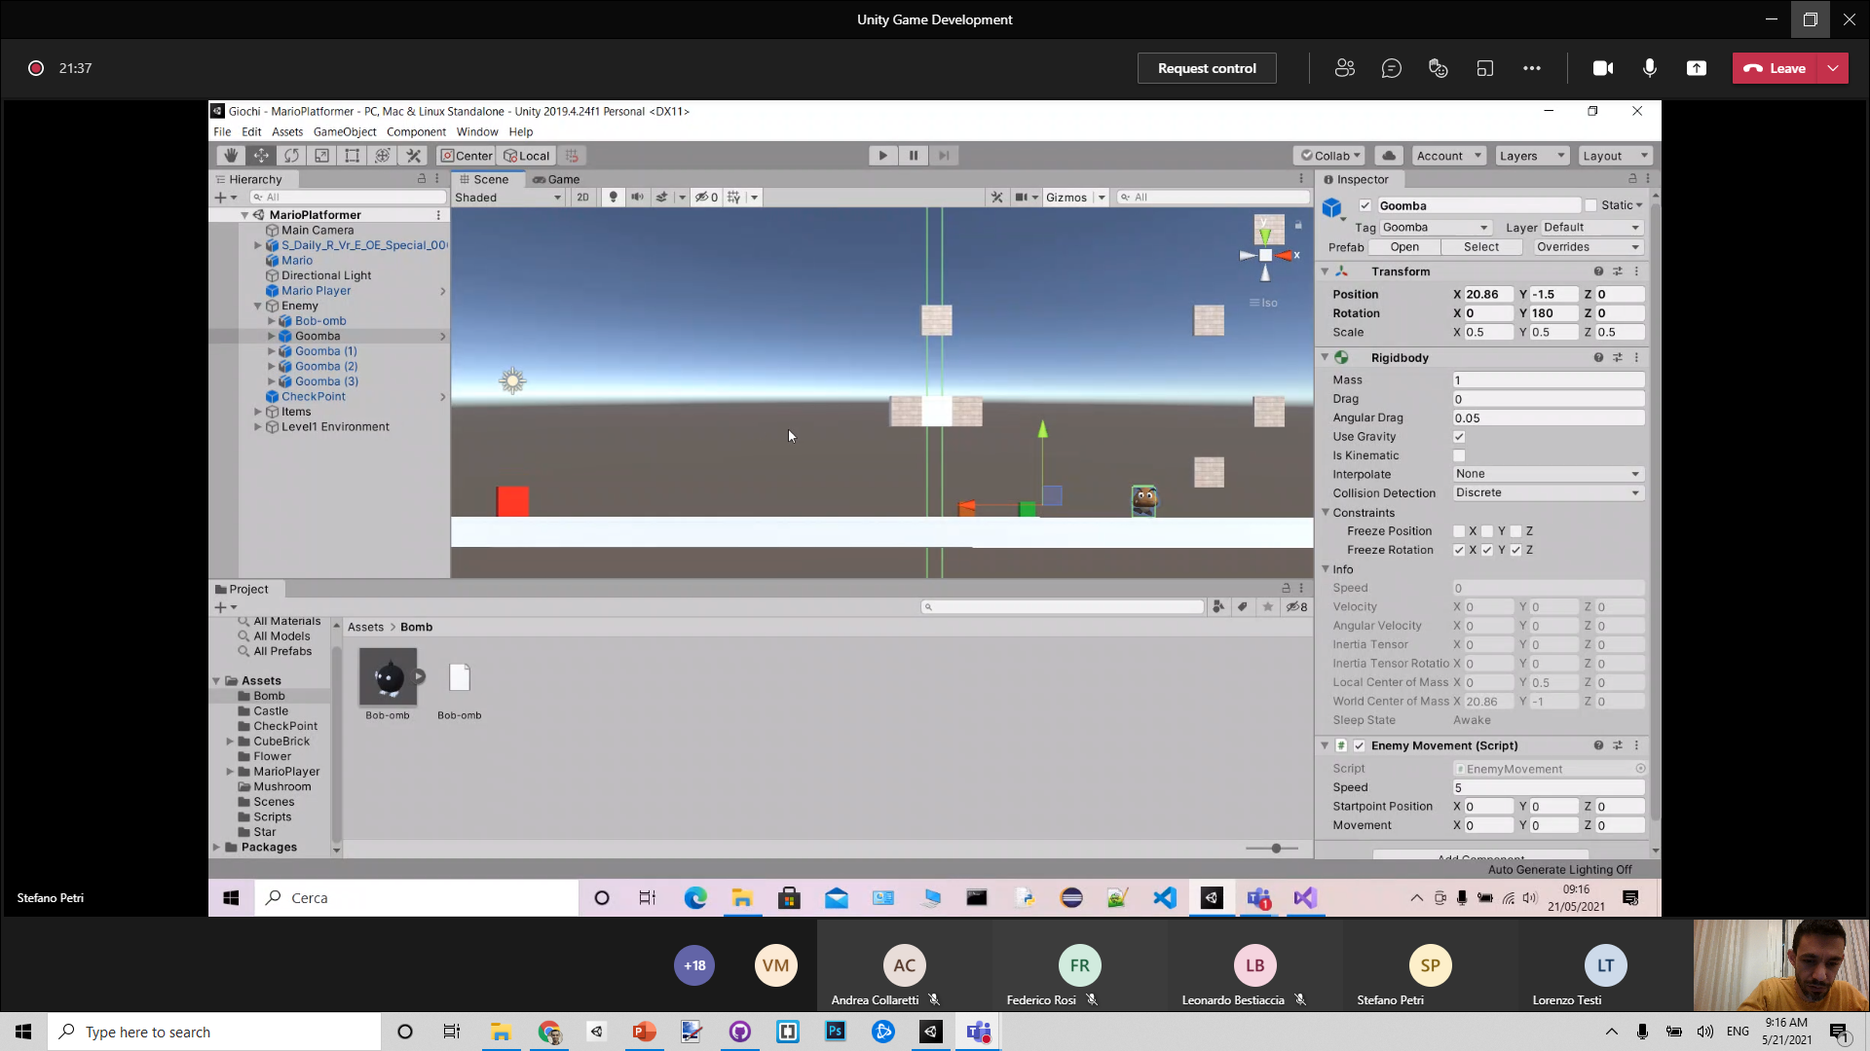

Slide 18
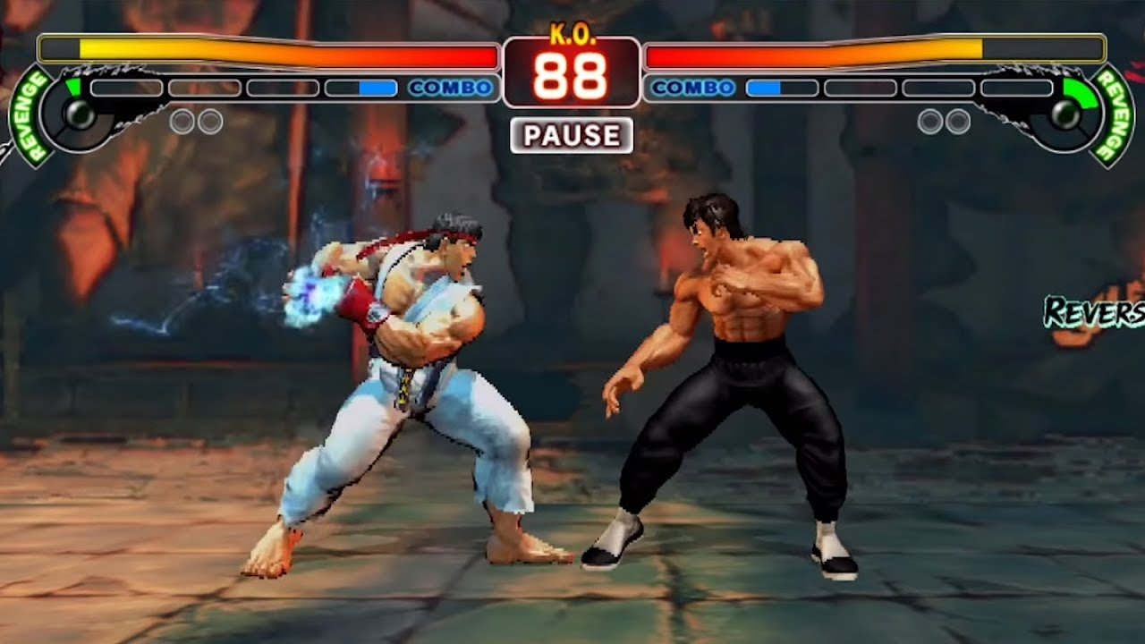

Slide 19
Enemy structure
Game object : Enemy
3d cube
Game object: Head
Top collider
Game object: 3d model of goomba
Body collider

Slide 20
Feature suggested from Stefano
1) Cannon that shoot away Mario.
2) Iterable block [?] that pop-up coins or other objects.
2.5) Multiple hit box, they will stop to give coins in a limited time.
3) Moving platforms that starts to move when Mario is on them.
4) Platforms that disappears after a certain period of time.
5) Hammer koopa (those that shoots hammers)
6) Checkpoint that set a new starting point of Mario.
here some ideas: Mario has a starting point value that set the character in a determinate position
in the game world. If he interact with a checkpoint, the starting point will be changed in a new
starting point.
7) Koopa (the turtles with the shells), with the animation (or not) of the shell in the game.
8) if (point 7){create two types of turtles: Red one (moves where is mario and does'nt fall), and the green (standard move)}
9) 2 layers of the game scene, for example we can put a door, and then Mario moves on the Z axis,
and we create a new layer of the level on that Z axis position.
10) Tubes/pipes/piranha pipes. If Mario interact with the right tube, it will go underground.
We can also create a piranha plant (Filippo's team will develop it).
11) Missile jack, that moves on the X axis.
12) In game music, that will also change (star theme, ending theme).
13) Timer for the game, if the count goes to 0, Mario will be destroyed.
14) Coins, everyone need coins! Also a display of the player's score.
15) Bowser that spit fire and hammers, and he also jump (maybe with a random function in an array of [3], hammer/fire/jump)
16) Fire wheels (cross) that Mario has to avoid.
17) Water spots that changes the game gravity if some objects enters there.

Slide 21
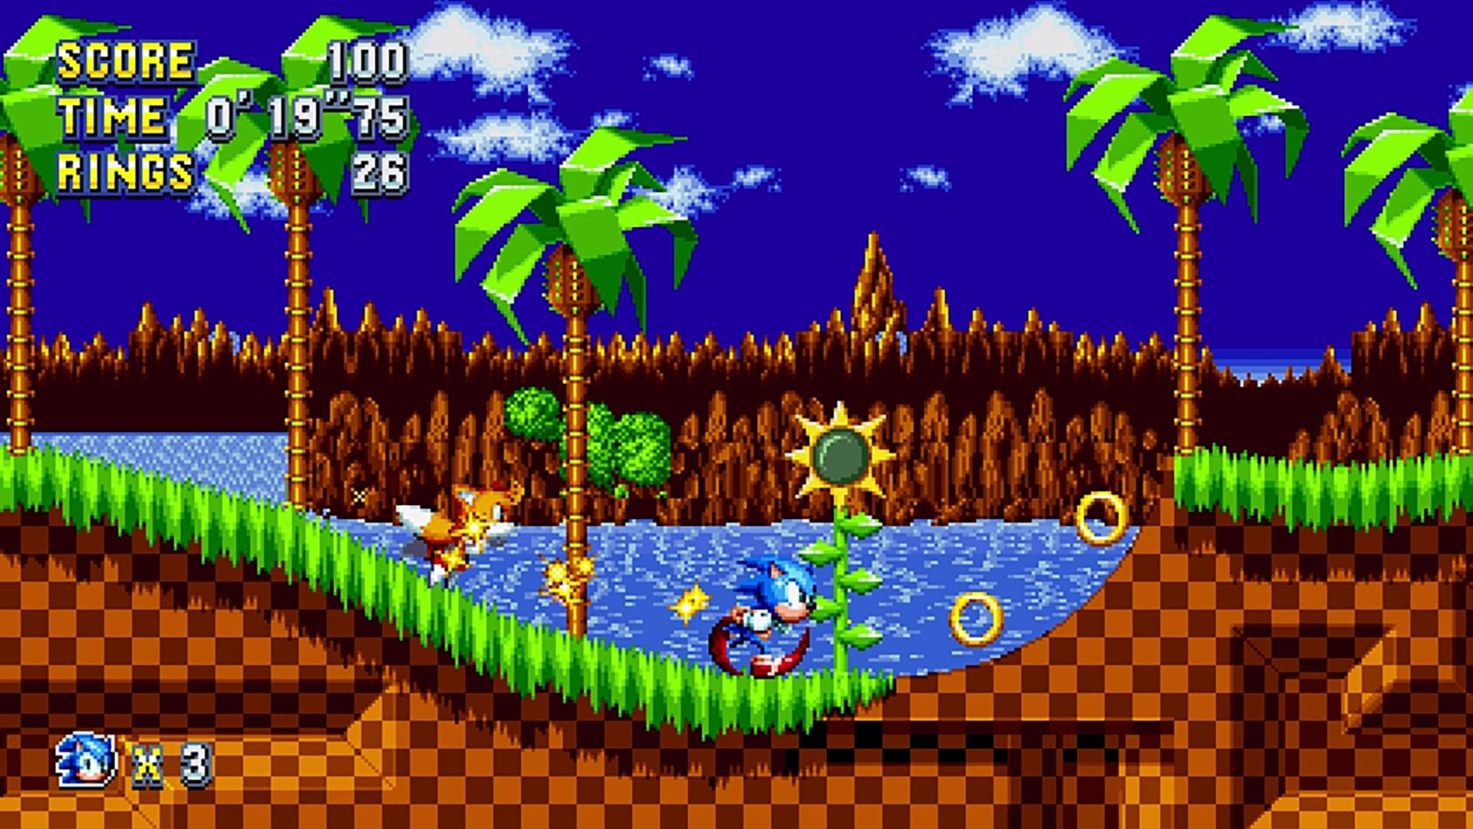
Jetpack
Collectable

Slide 22
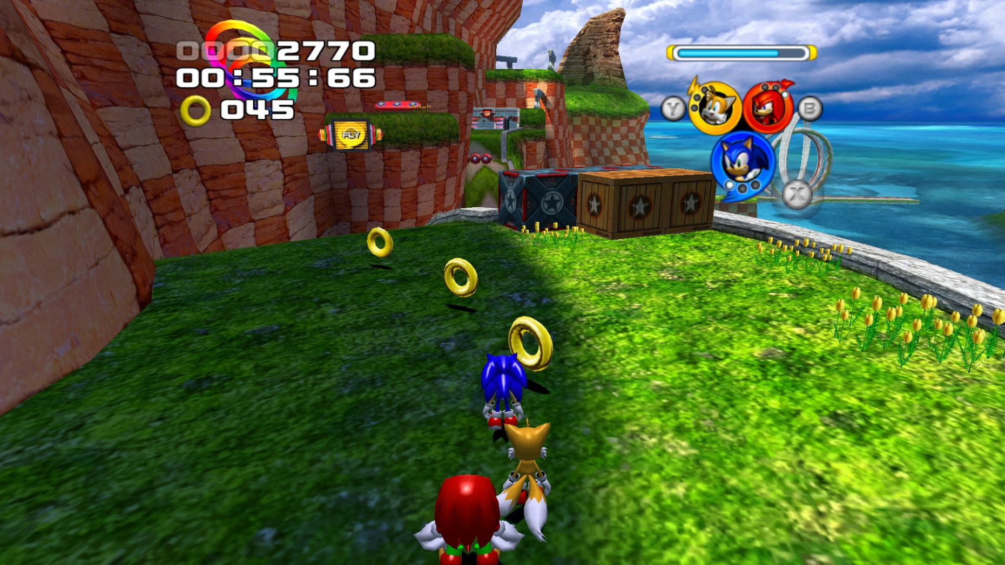

Slide 23
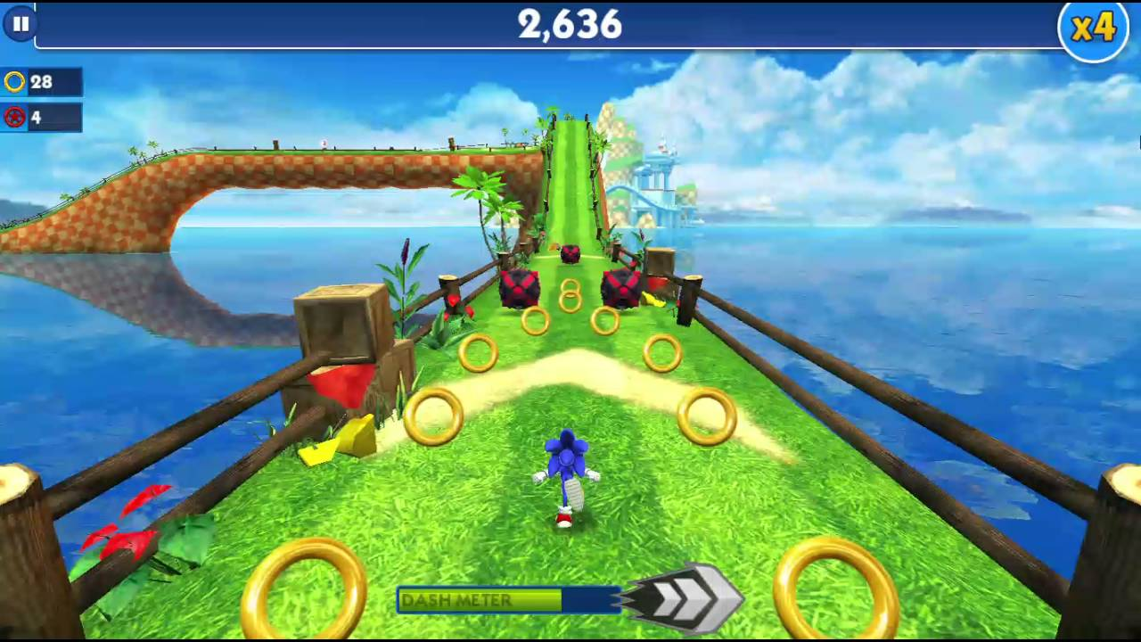

Slide 24
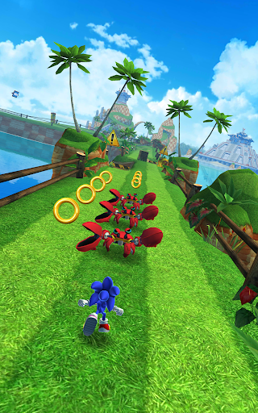

Slide 25
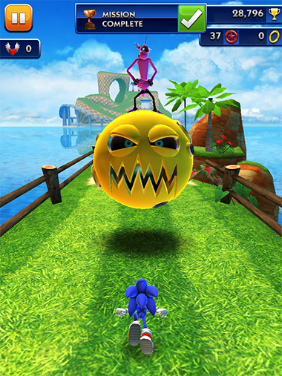

Slide 26
